Slide 1
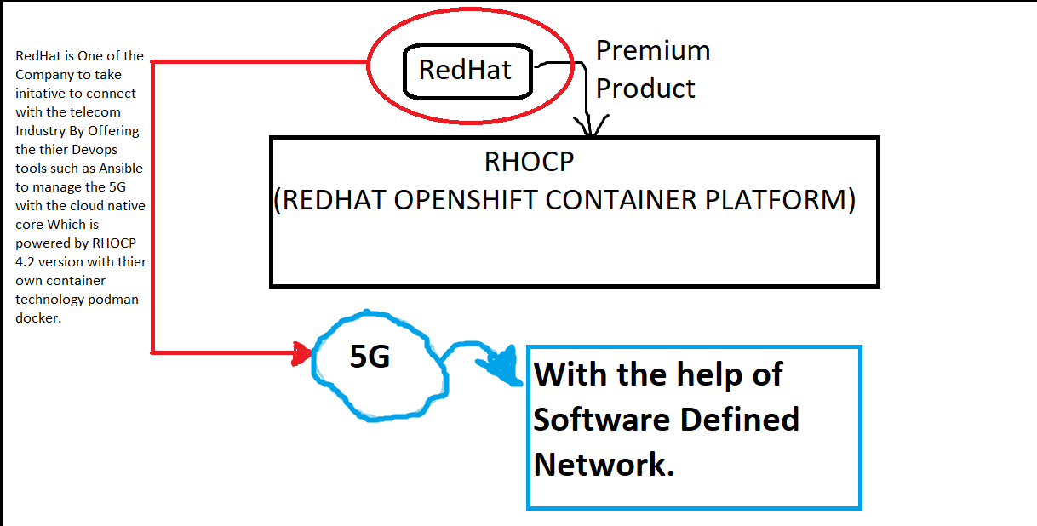
OpenShift 4.2
1
2
3
4
5

Slide 2
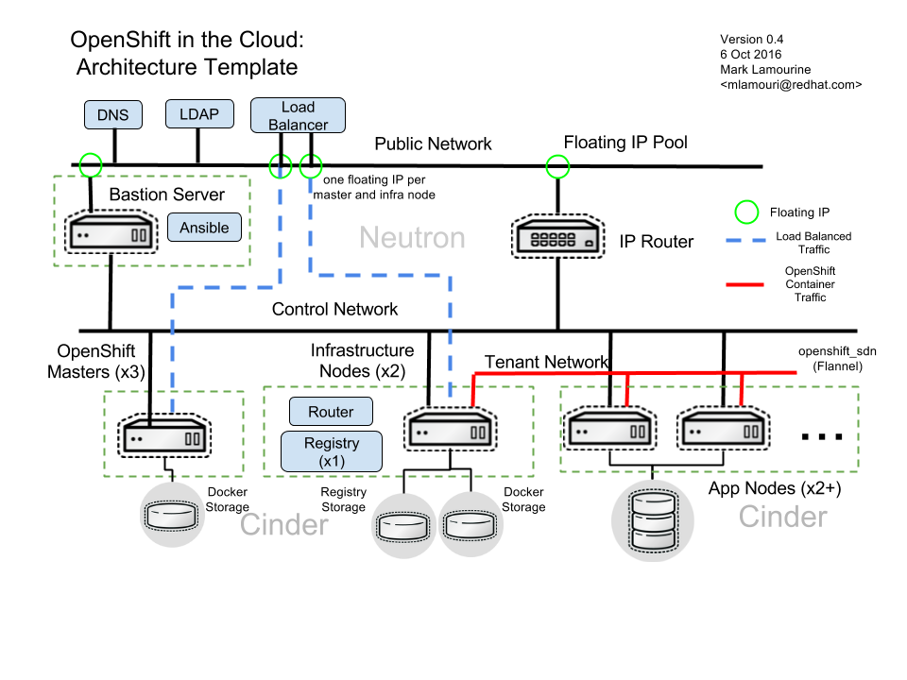
What is RHOCP ?
“ Red Hat OpenShift Container Platform is a container application development and hosting platform that provides
compute services on-demand. It allows developers to create and deploy applications by delivering a consistent
environment for both development and during the run-time life-cycle that requires no server management ”
Refrence: https://www.openshift.com/products/container-platform

Slide 3
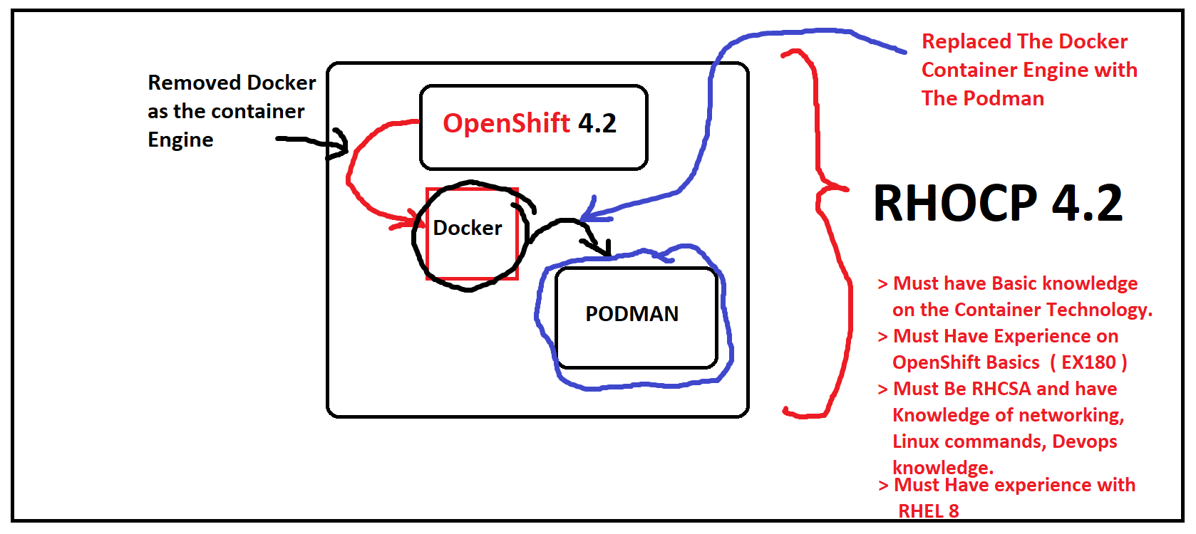
1
2

Slide 4
Prerequisite
> Become a Red Hat Certified System Administrator (RHCSA) or have comparable work experience and skills
> Take the Red Hat OpenShift Administration I (DO280) course or have comparable work experience using OpenShift Container Platform

Slide 5
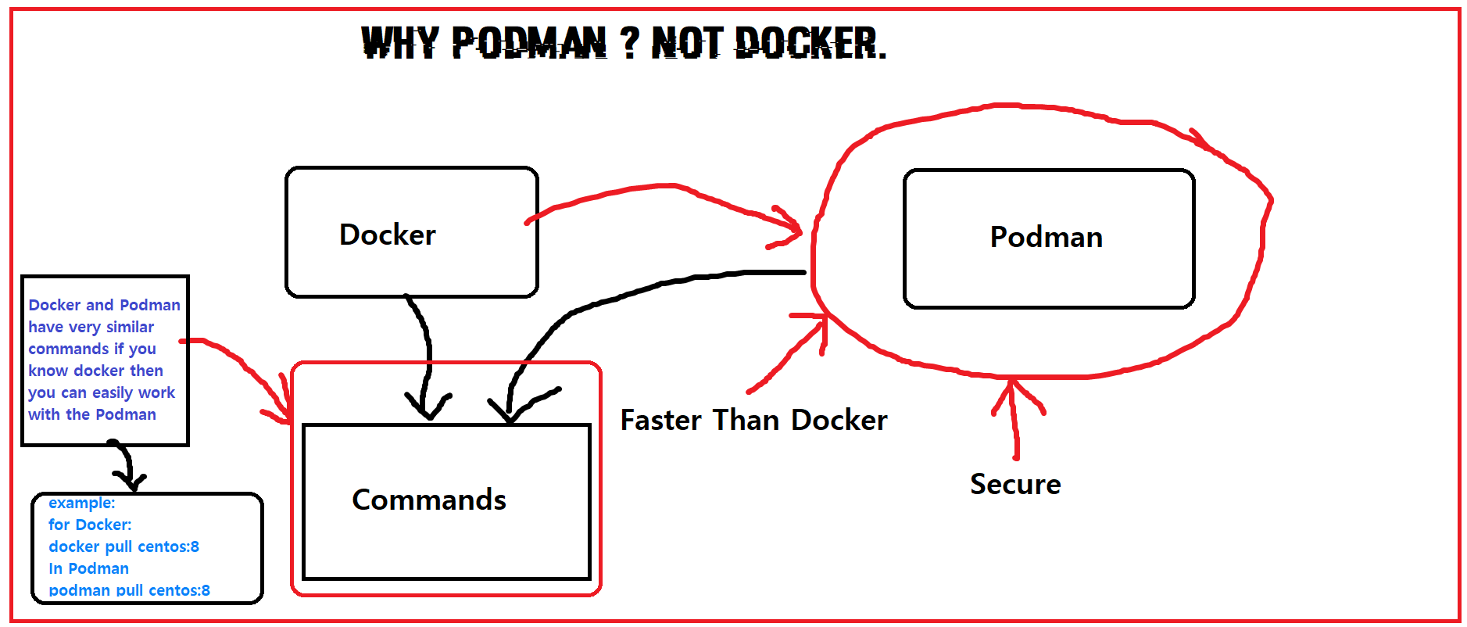

Slide 6
Why use Podman not docker?
> Firstly , migrating from Docker to Podman is very easy.
> You need to install Podman instead of Docker. You do not need to start or manage a daemon process like the Docker daemon.
> The commands that you use with Docker will be the same for Podman.
> Images of Docker is compatible with Podman.
> Podman stores its containers and images in a different place than Docker.

Slide 7
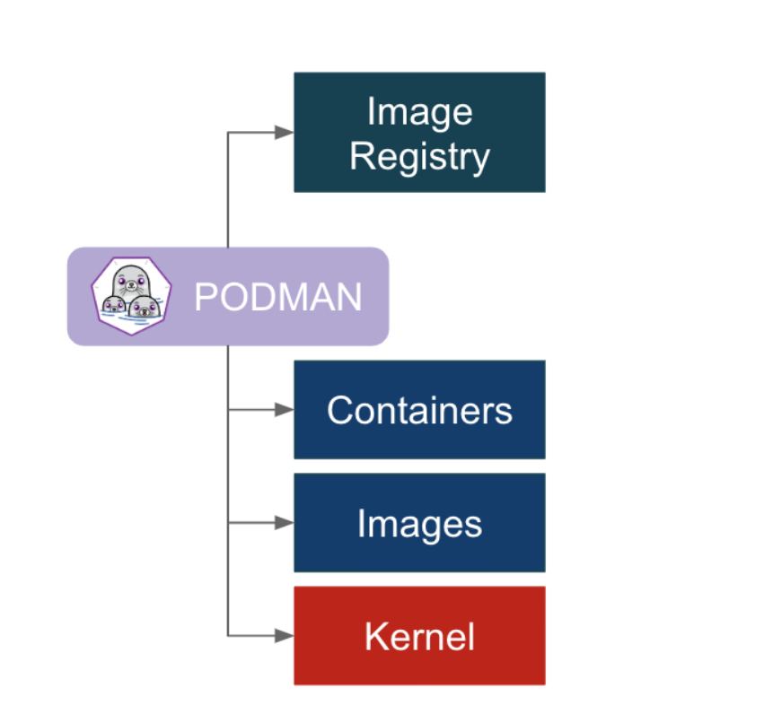
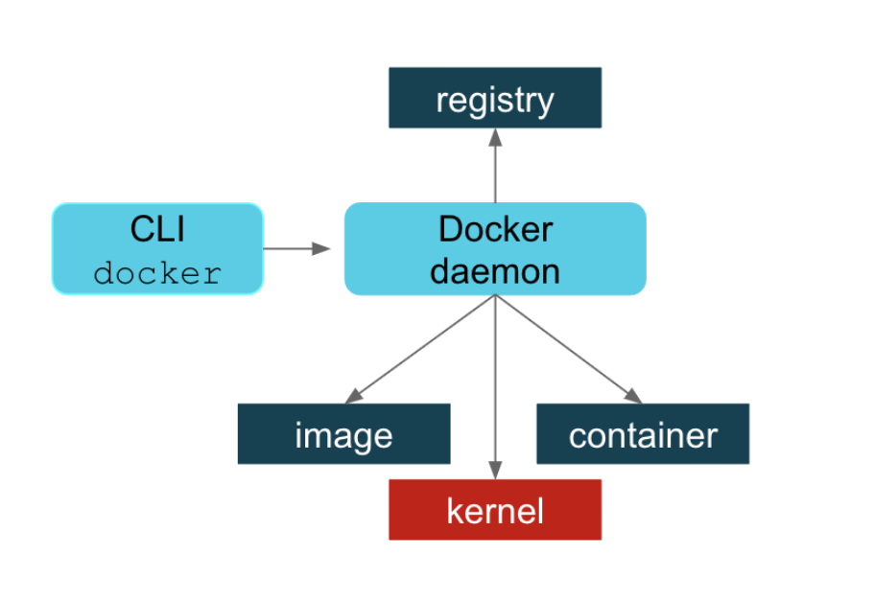
Podman Vs Docker Architecture

Slide 8
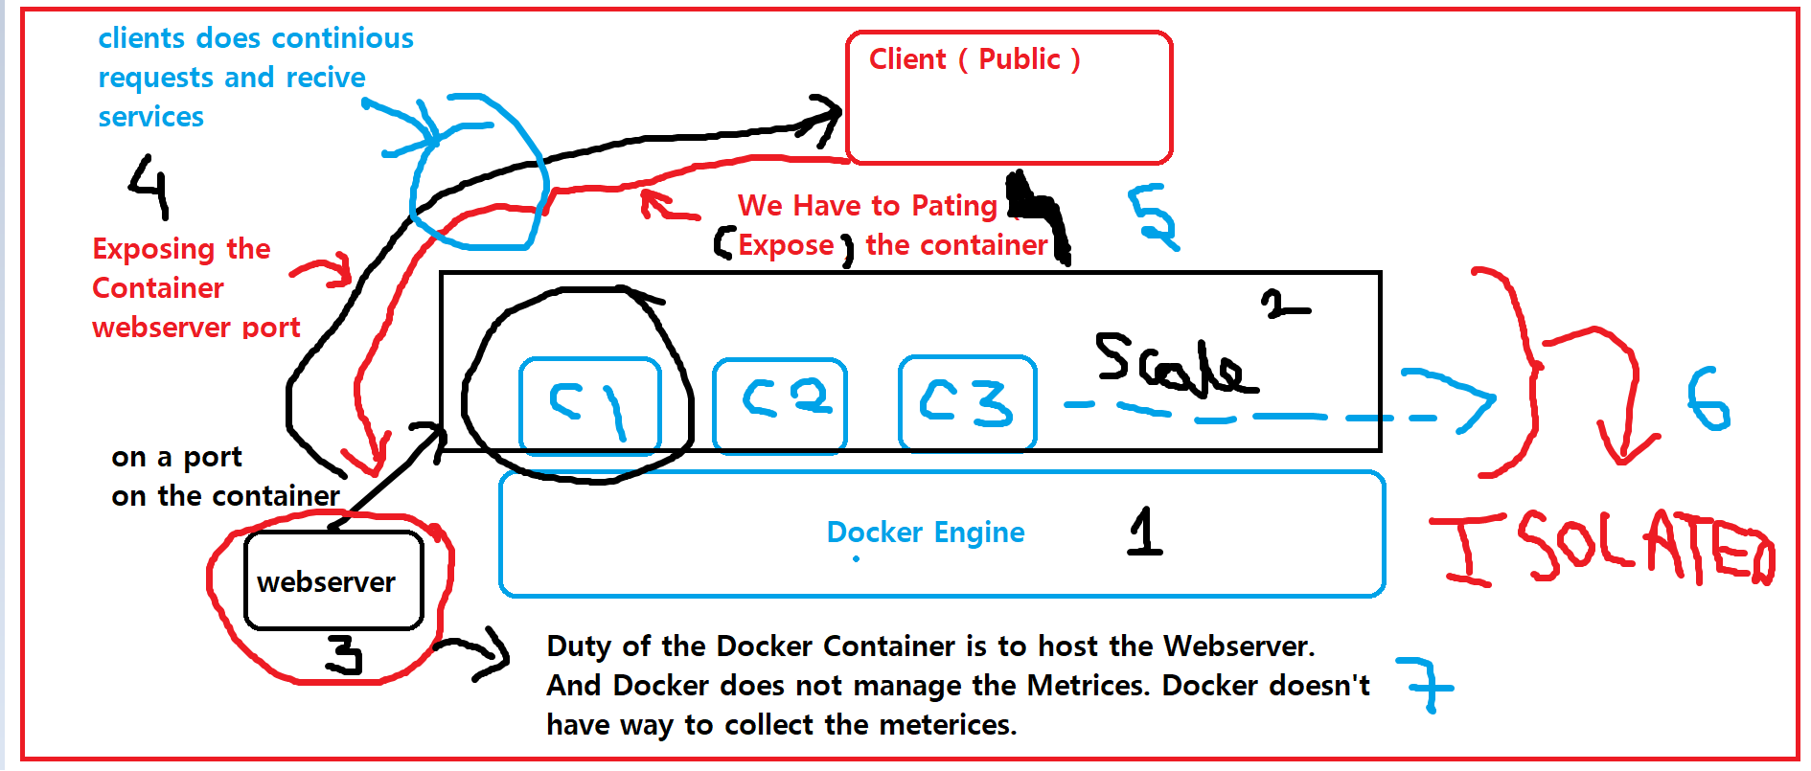

Slide 9
Previous slide in detail
To use the Docker engine we need and hardware and O.S. on the Top of which we run our Docker Engine.
On the top of the container engines we launch or build the containers which we can scale depending on the resources.
Those container we use as webservers, db servers or any other servers which is efficient way to utilize the resources properly.
We have to expose ( patting ) the range of ports to provide services to the client.
Every container is isolated in docker we have to expose them so customers can communicates to the containers via ports and access the services.
Duty of the docker container engine is not created to manage and collect metrices ( resources ).
To handle the demands of the clients we have to maintain the metrices and provide them the great User Experience.

Slide 10
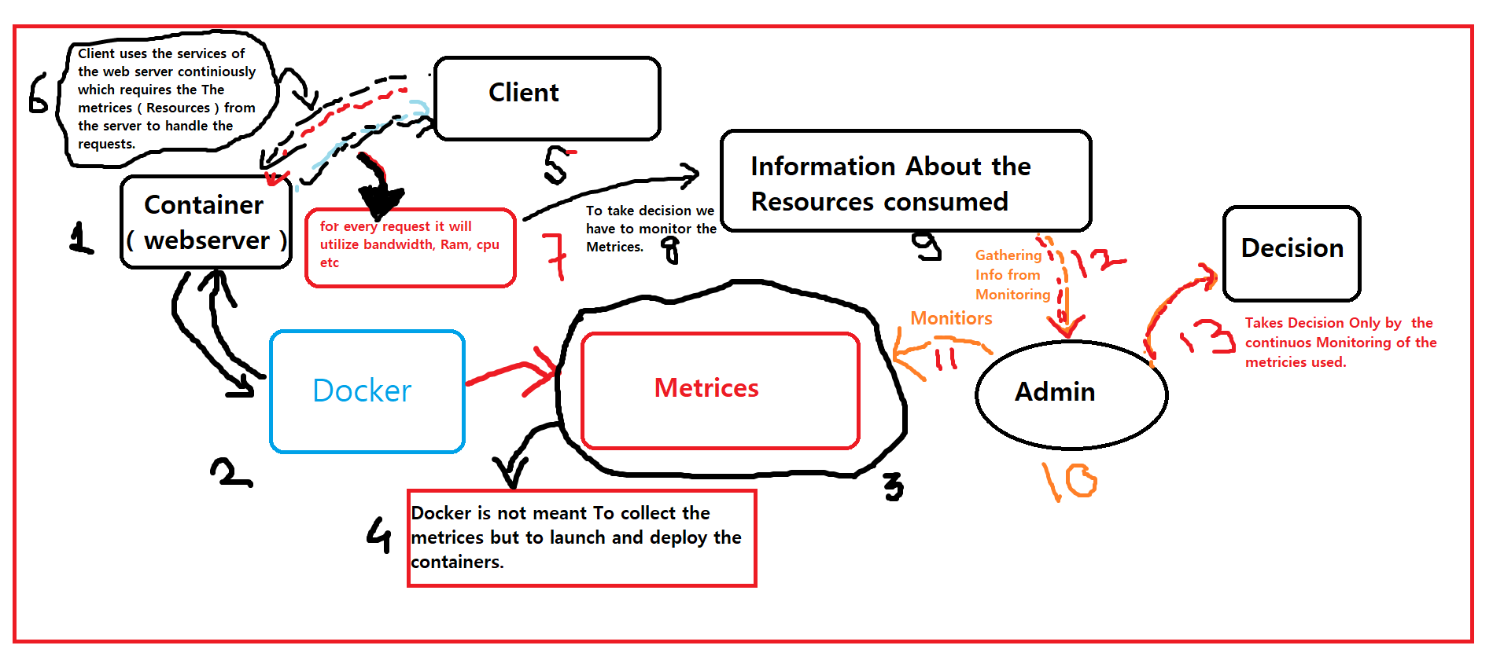

Slide 11
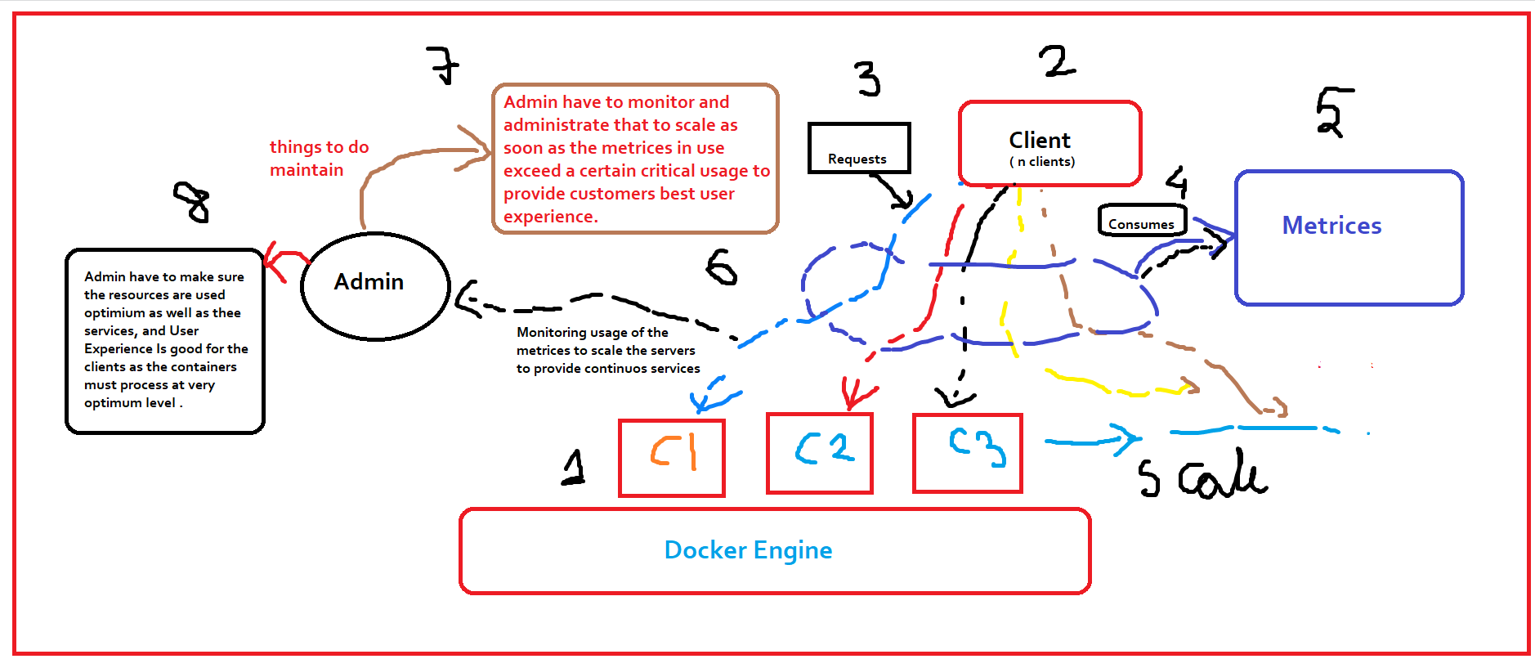

Slide 12
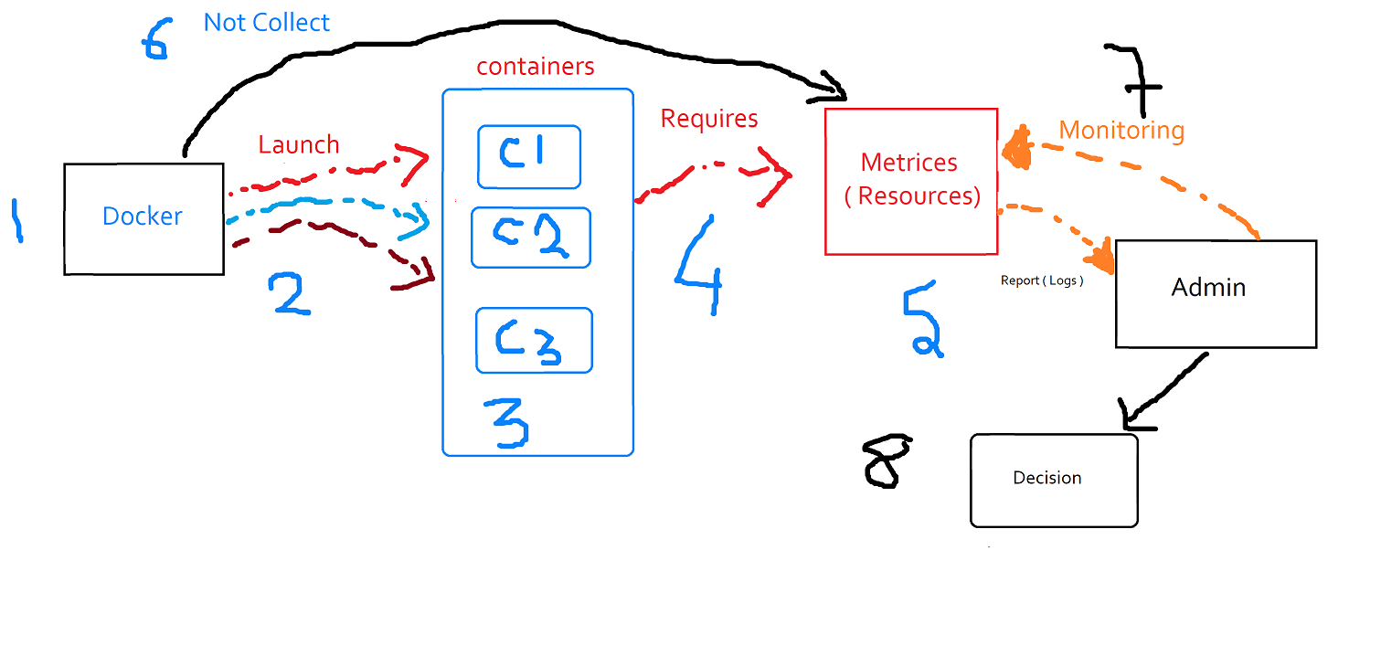

Slide 13
Previous slides in detail
We use docker engine to launch the containers and use those containers to use as webservers, db servers etc.
Docker engine requires metrices like ram , cpu etc to launch the containers.
To monitor the usage of the metrices the IT Ops or the Admin continuously monitors the metrices and take further decision such as adding a volume storage via ISSCI or any other methods like the use of Ceph, Glusterfs.
Docker is meant to launch and deploy the containers the Admin uses other tools to collect and provide the metrices for the engine.
To provide the great user experience we need to have very agile services and provide services to the customers properly else it will make us loose the clients. “ Every millisecond matters ”
The every time a client access the server it requires the resources to provide the stable and agile services to clients to handle that load we use load balancers such as haproxy which uses round robin algorithm by default to provide stable, agile and balanced services.

Slide 14
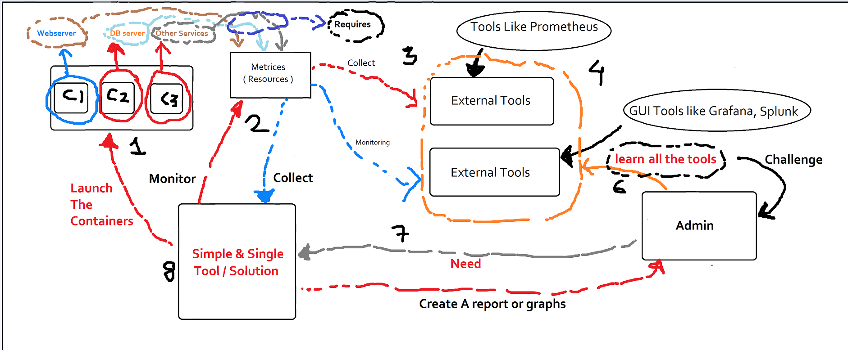

Slide 15
Previous slide in detail
We deploy containers which we may use as webservers they require metrices.
We have external tools to collect the metrices also we have tools to monitor the metrices such as Grafana, Splunk ( Operational Intelligence to read logs ) .
The challenge for any Admin or IT ops guy is to learn all those tools one by one and in case new better tool came up do same process for it.
What companies now require is a simple unified single tool to have all these features and which collect metrices, monitor it, generate a report for Admin to take further decisions on the basis of those reports.

Slide 16
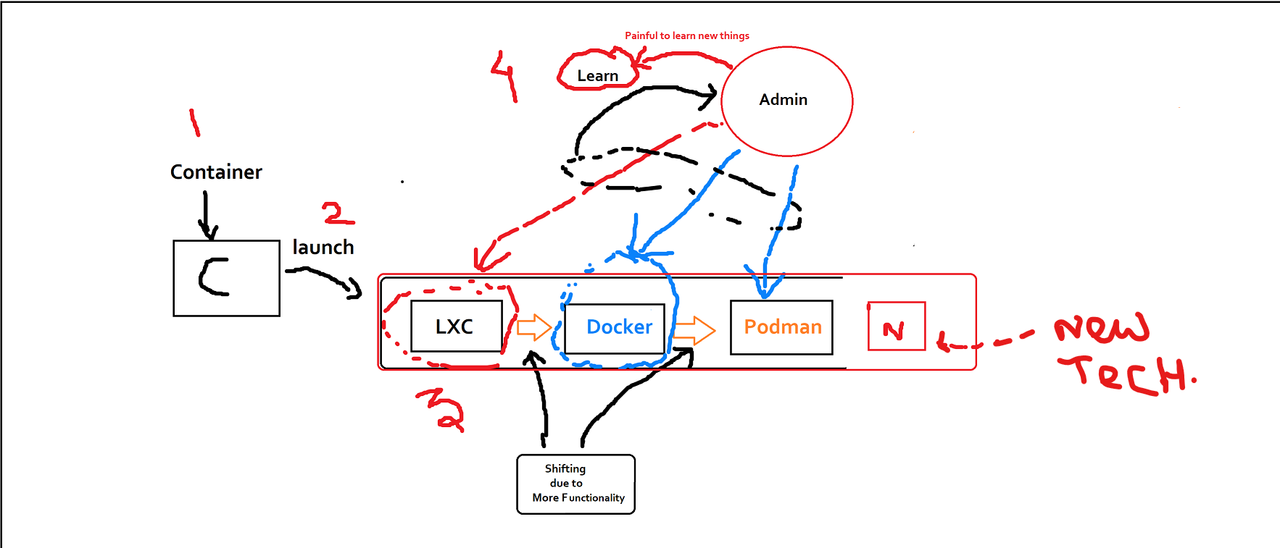

Slide 17
Previous slide in detail
Same thing is for the container engines whenever a better engine comes in we have to migrate or shift the infrastructure to it which may take too much time , investment to migrate on that infrastructure.
To launch a container we require some container engine to launch the container on the top of the container engine.
For container engine from LXC -> Docker - > Podman -> better agile container engine ( future ).
The challenging thing for anyone to learn the container engines whenever better container engine comes into the picture due to this we use Container Platform.

Slide 18
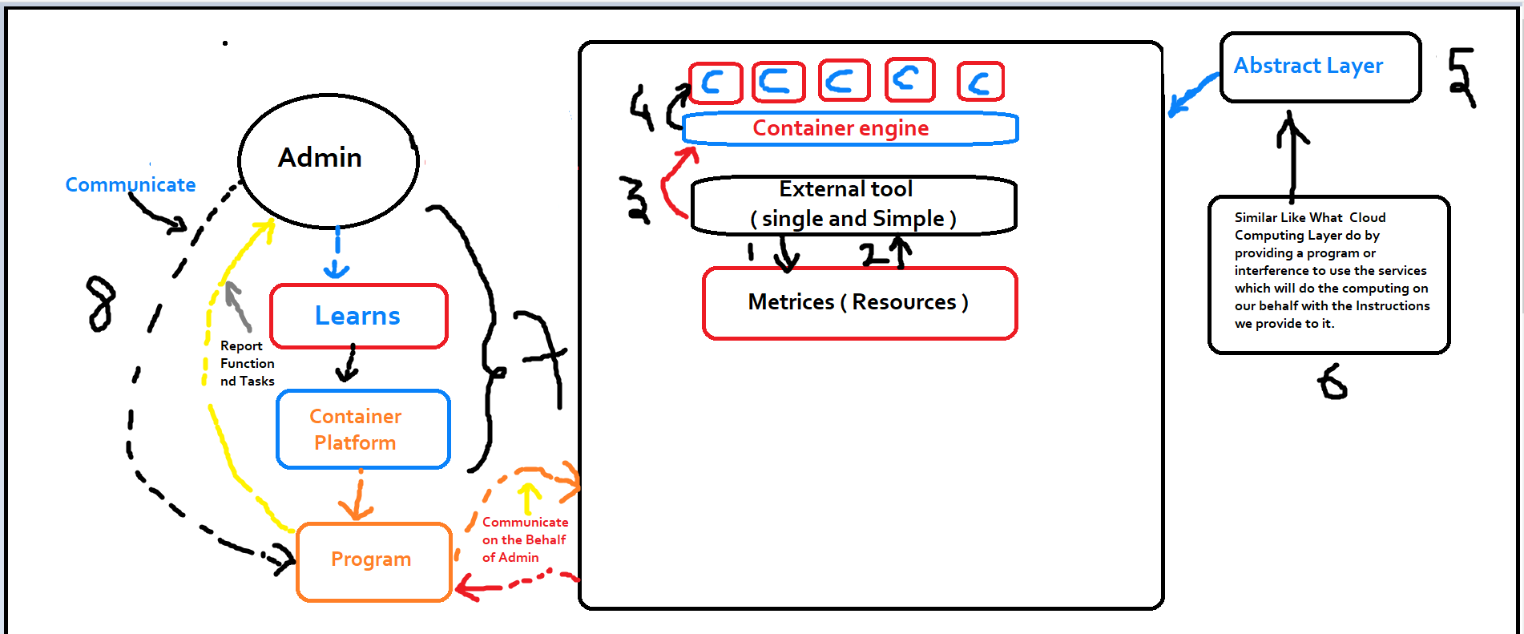

Slide 19
Previous slide in detail
Admin need to learn a single product or the container platform due to which we need not to learn the container technology to deploy containers .
Admin learns the container platform then use the platform which on behalf of the Admin communicate with the abstract layer which provides the same features for which we had to use external tools to access them.
Abstract layer is like a smart layer like the cloud computing layer all Admin need is to give orders to it which on behalf of admin does all the tasks that Admin wants to perform.

Slide 20
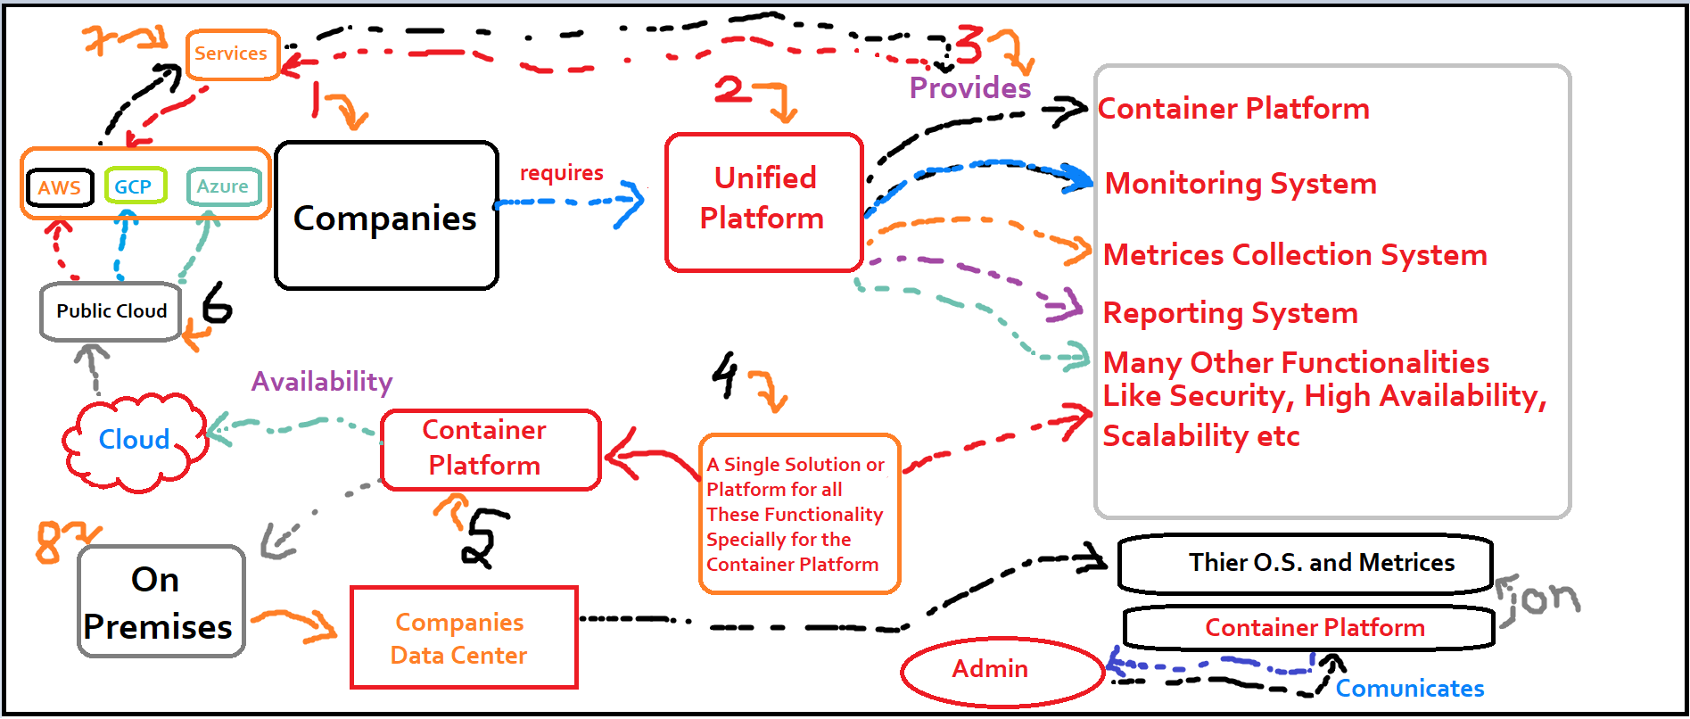

Slide 21
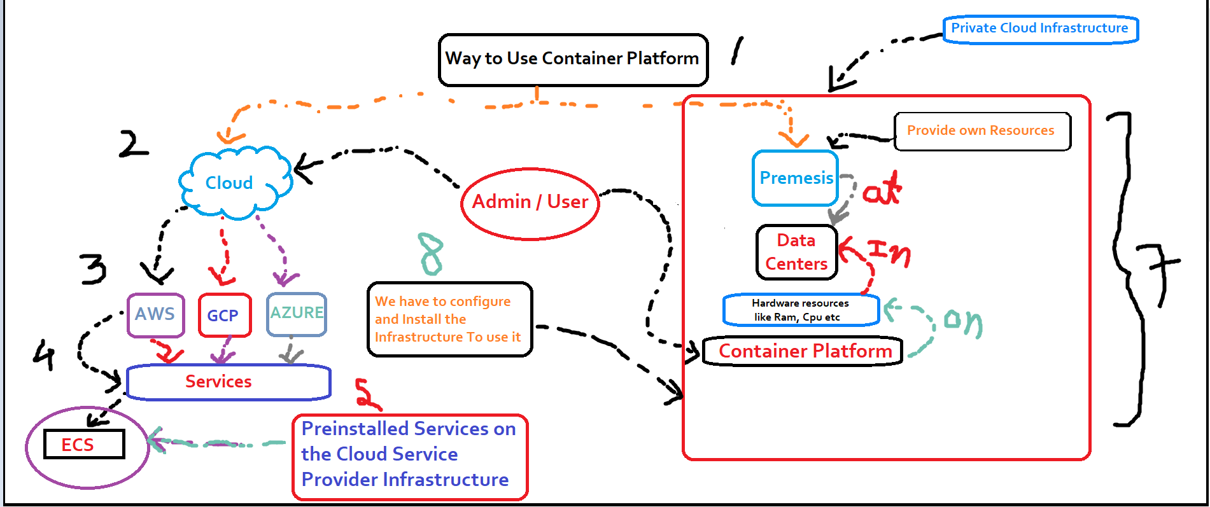

Slide 22
Previous slide in detail
What companies required is a single unified simple platform which provides them features like:
> Container Platform
> High Availability.
> Reliability.
> Monitoring system.
> Metrices collection.
> Reporting system.
> Security and many other features.
For the container platform infrastructure we can deploy it on two platforms:
> Public Cloud infrastructure.
> On premises ( Private Cloud infrastructure ).
Public Cloud Infrastructure: in this infrastructure we already have the services to provide the container platform. example : AWS , GCP, Azure etc in AWS the service we can use is ECS ( Elastic Container Service ).
On Premises ( Private Cloud Infrastructure ): In this infrastructure we deploy our container platform on the top of own Hardware resources such as RAM, CPU, STORAGE we use O.S. to communicate with these hardware with the help of the kernel to provide those features. We can also deploy the Container platform on the top of the OpenStack platform which will Provide us both PAAS and IAAS infrastructure.

Slide 23
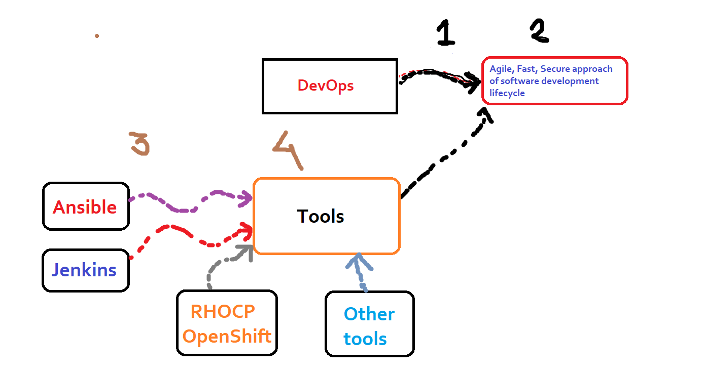

Slide 24
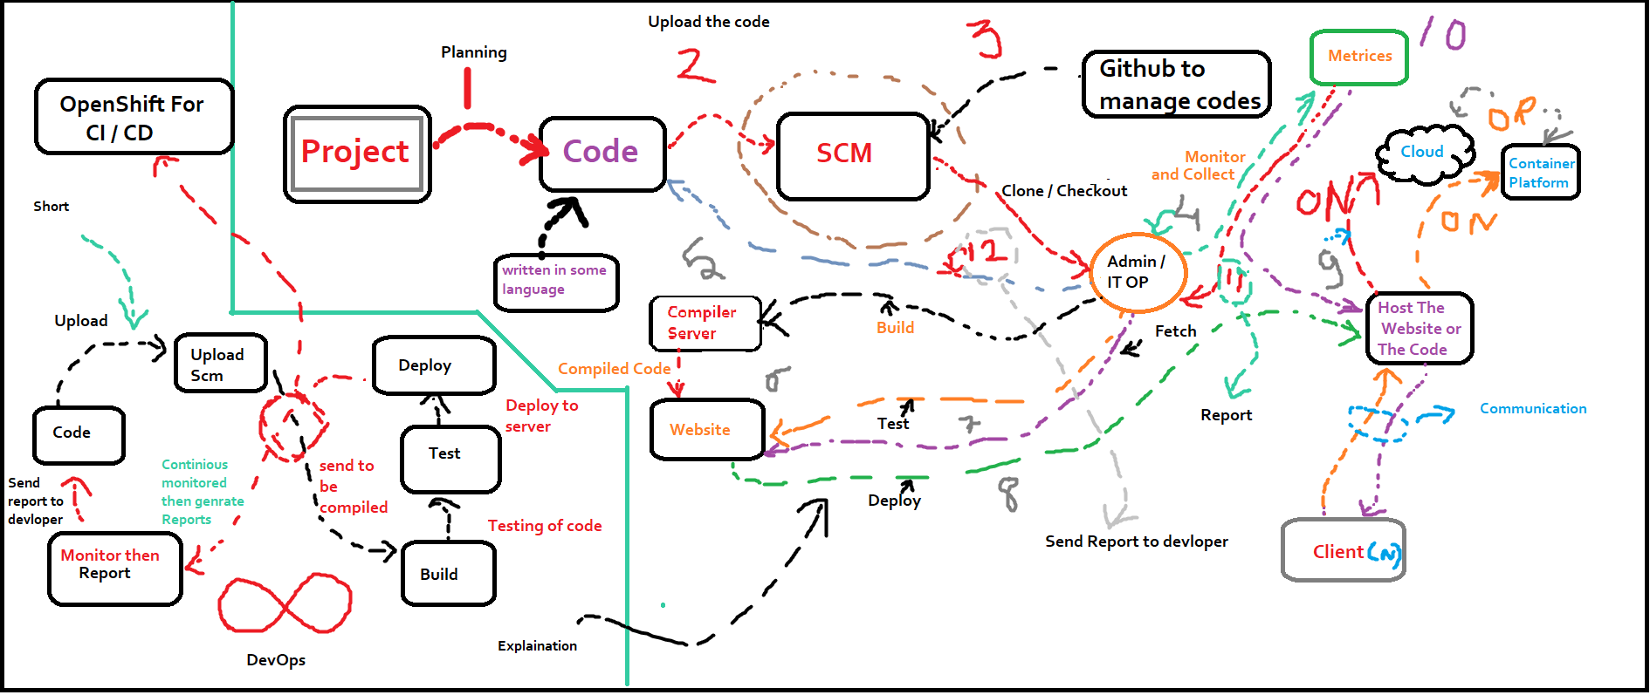

Slide 25
Previous slides in detail
DevOps: It is agile, fast, secure approach which is being used in every IT sector to provide the services with greater user experience.
2. Process:
> Whenever a project come in the company they plan and then start the coding for the solution of the project.
> Here solution means the solution of the problem which client asked us to provide a solution for that due to this we call it the solution for
the project.
> The Developers then pushes the code on the SCM ( Sources Control Management System ) like GitHub ( works on DVCS + CVCS Both ) to
manage the codes or the projects on which various developers collaborate and co-operate and Pushes the code back to the Repository.
> The Codes or the project is then pulled / Cloned / Checkout by the Admin / IT Operations Guy then he sends the project to build it (
compile the codes ) by forwarding the project to the compiler server.
> The compiler server then sends the build to be tested on the servers ( Testing Servers ) .
> After the build passes those tests then the build is then deployed to the servers so that client can start taking use of the solution.
> IT Ops Guy will continuously monitors the metrices consumed by solution that the client use and continuously monitors the services
provide by the solution to the client.
> Whenever the client face any issue he will raise a ticket which will in turn known by IT Ops guy and generate a report and forward the
report to the Development team.
> The Development team will again resolve and update the code and the pushes project codes again to the SCM then this cycle continues
this unending Software Development is known as DevOps Approach.
3. The tools we use for the DevOps process are Jenkins, Ansible, RHOCP, Puppet and many other tools.

Slide 26
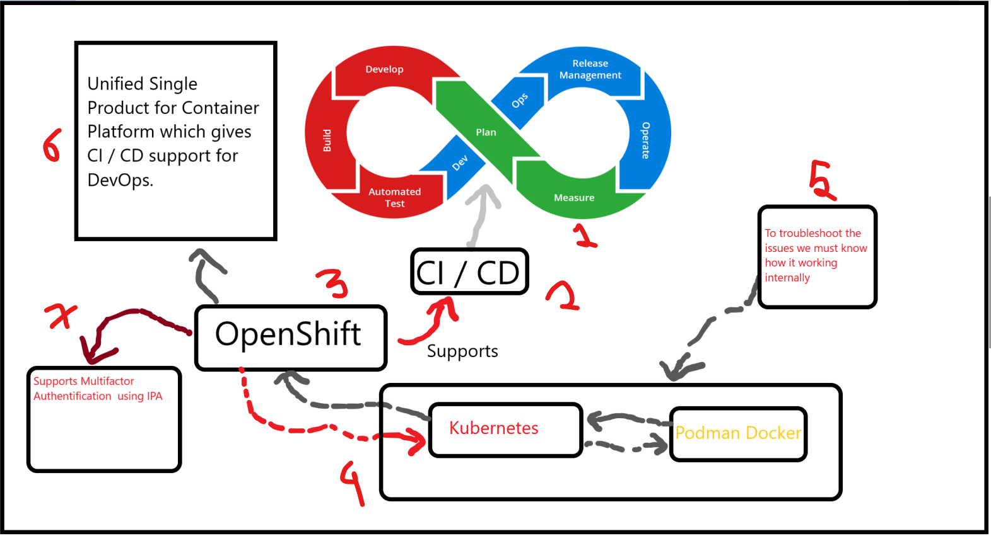

Slide 27
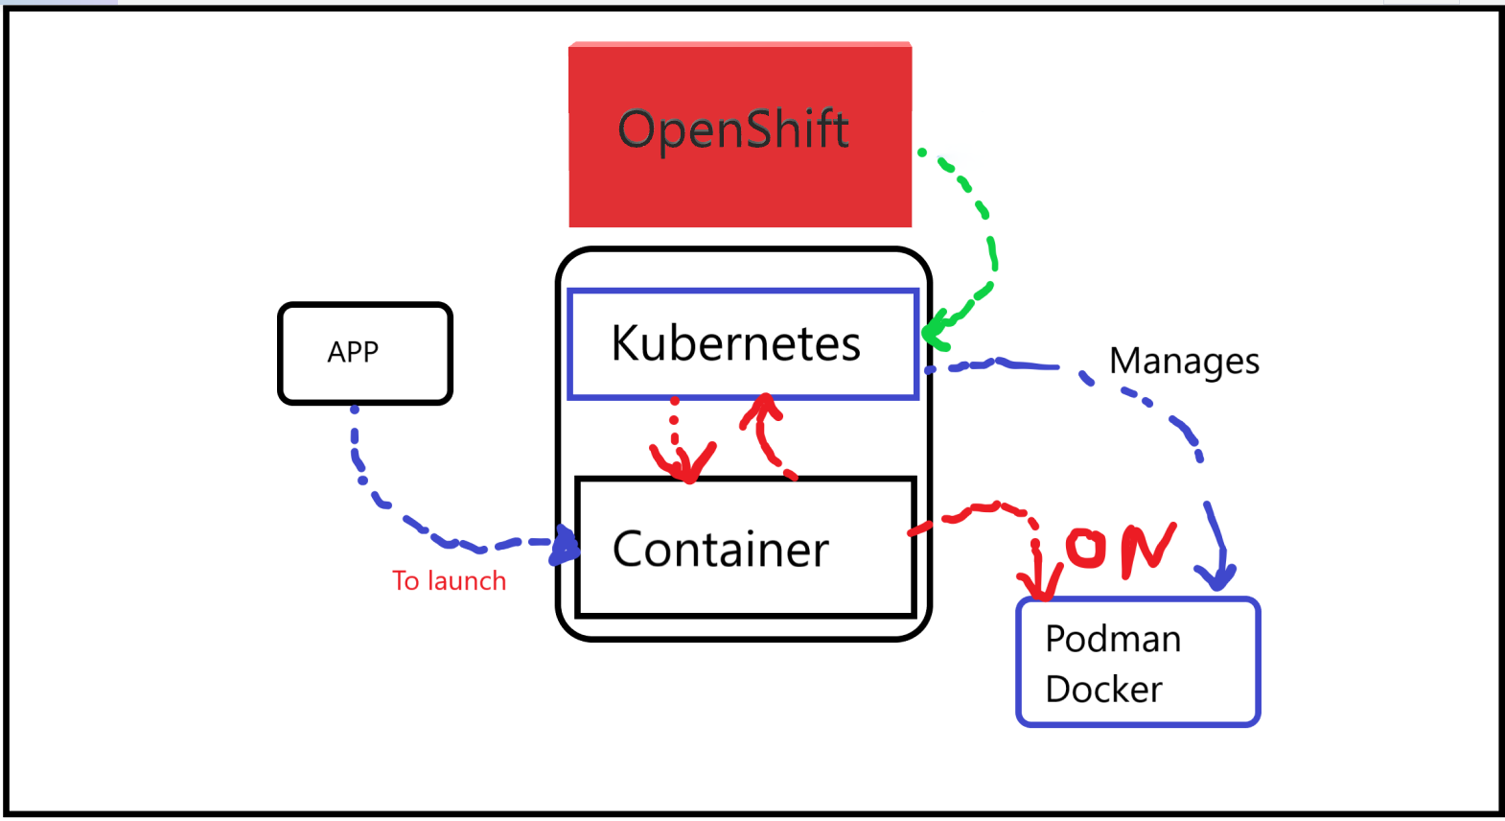

Slide 28
Previous slides in detail
Here the RHOCP 4.2 can be used like CI/CD for the DevOps process also have many other features.
RHOCP 4.2 uses Podman and Buildah as the container engine it is a must to know if we want to trouble shoot the issues about the container engine.
OpenShift uses Kubernetes to manage the containers and deploy containers ( pods in the case of RHOCP using Podman ).
OpenShift have multifactor authentification using IPA ( lDAP, Kerbros, SSSD ).

Slide 29
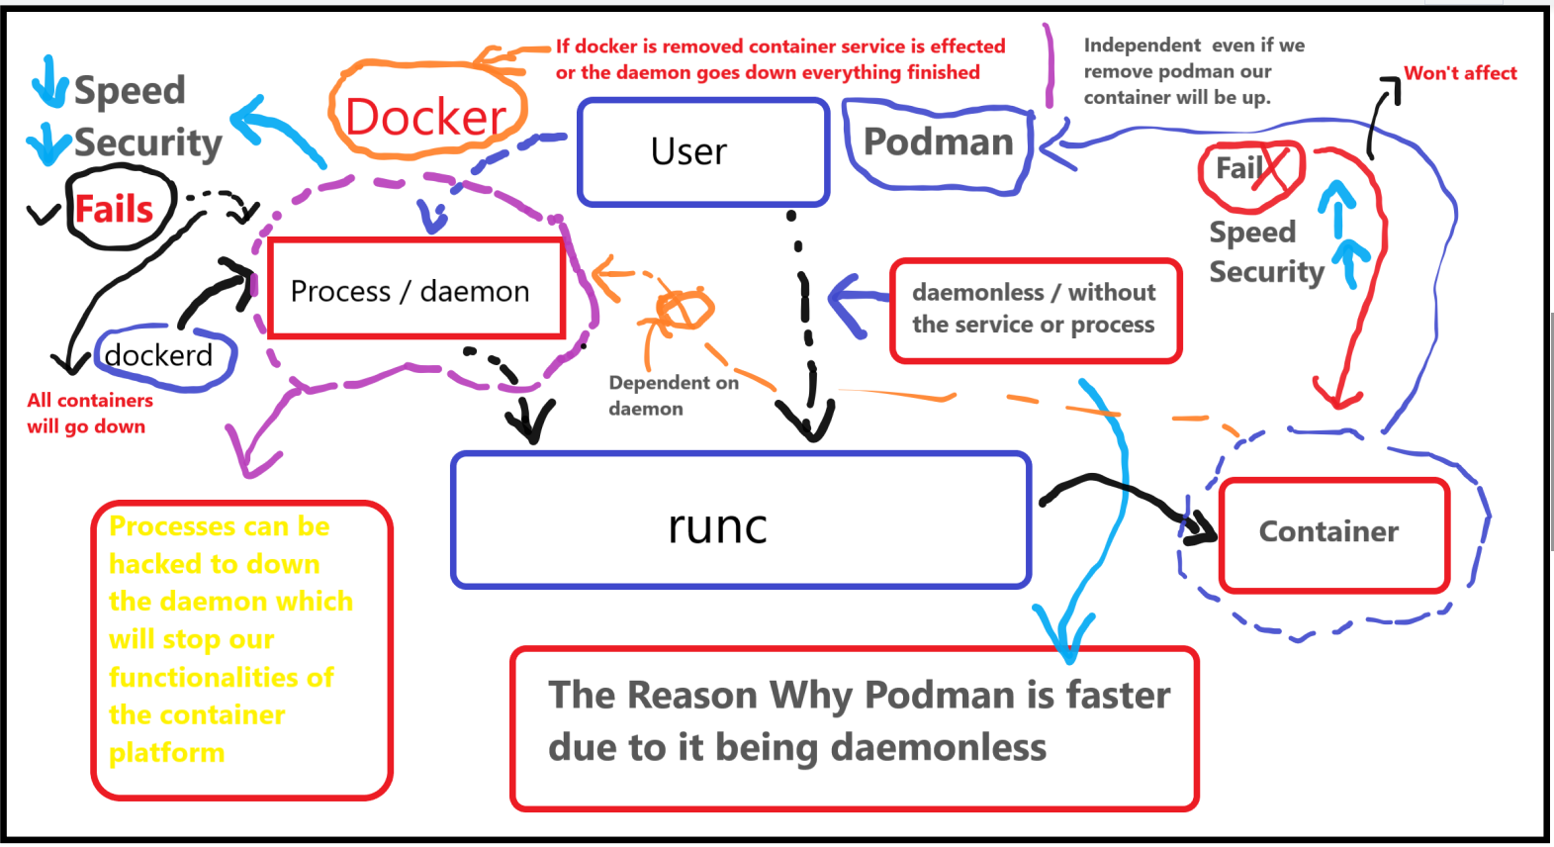

Slide 30
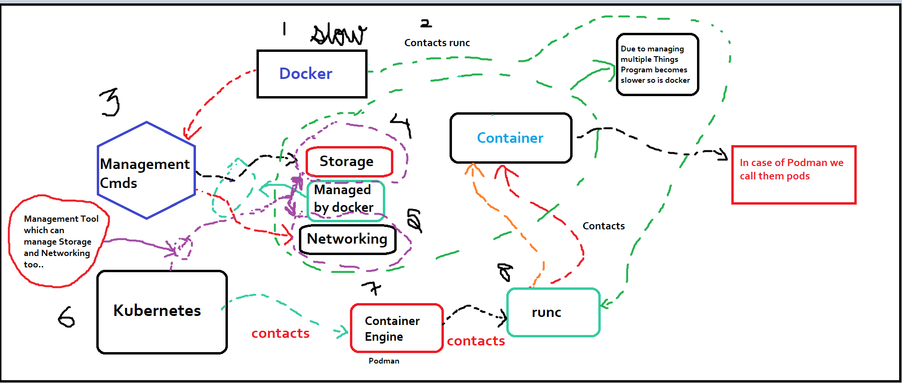

Slide 31
Previous slides in detail
Docker:
Docker is slower as compared to the Podman.
Docker engine contacts dockerd ( process / daemon ) to contact runc to deploy the container.
If the docker engine crashes all the container will also be affected.
Due to docker using processes that are venerable and can lead to failure of the services given by the containers running on the top of the docker engine.
Docker also gives additional features to manage storage ( volume ) , Networking due to these reasons docker becomes slow.
Docker is less secure due to it being using the daemon.
Podman:
Podman is faster as compared to the Docker.
Podman engine contact runc directly to deploy the container.
If the podman engine crashes all the container will not be affected.
Due to Podman being daemonless it is more secure than the docker and failure of the podman engine won’t affect the pods running on the top of the podman engine.
Podman sole purpose is to launch containers.
Podman is more secure due to it being daemonless
Migrating from Docker to Podman is very easy.
You need to install Podman instead of Docker. You do not need to start or manage a daemon process like the Docker daemon.
The commands that you use with Docker will be the same for Podman.
Images of Docker is compatible with Podman.
Podman stores its containers and images in a different place than Docker.

Slide 32
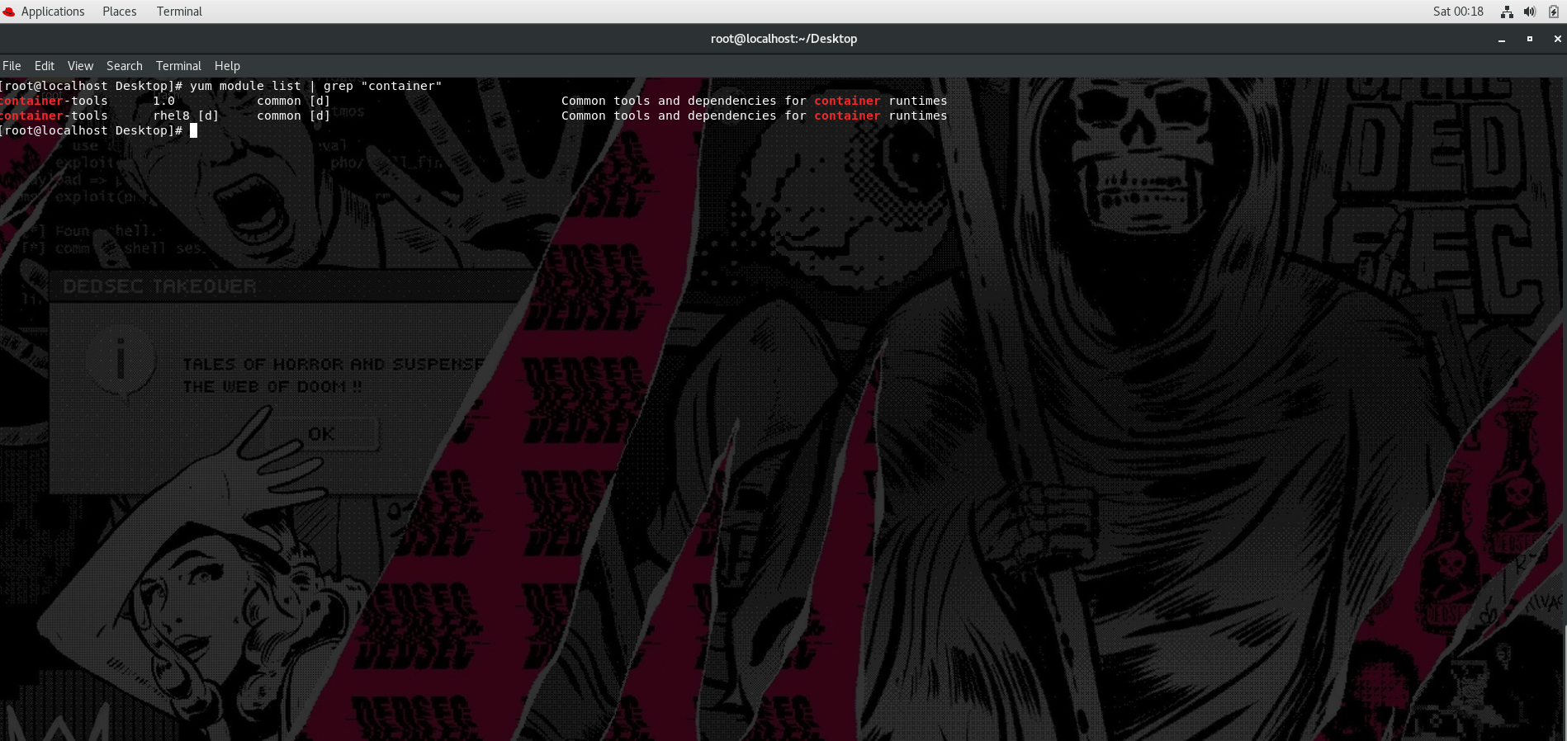

Slide 33
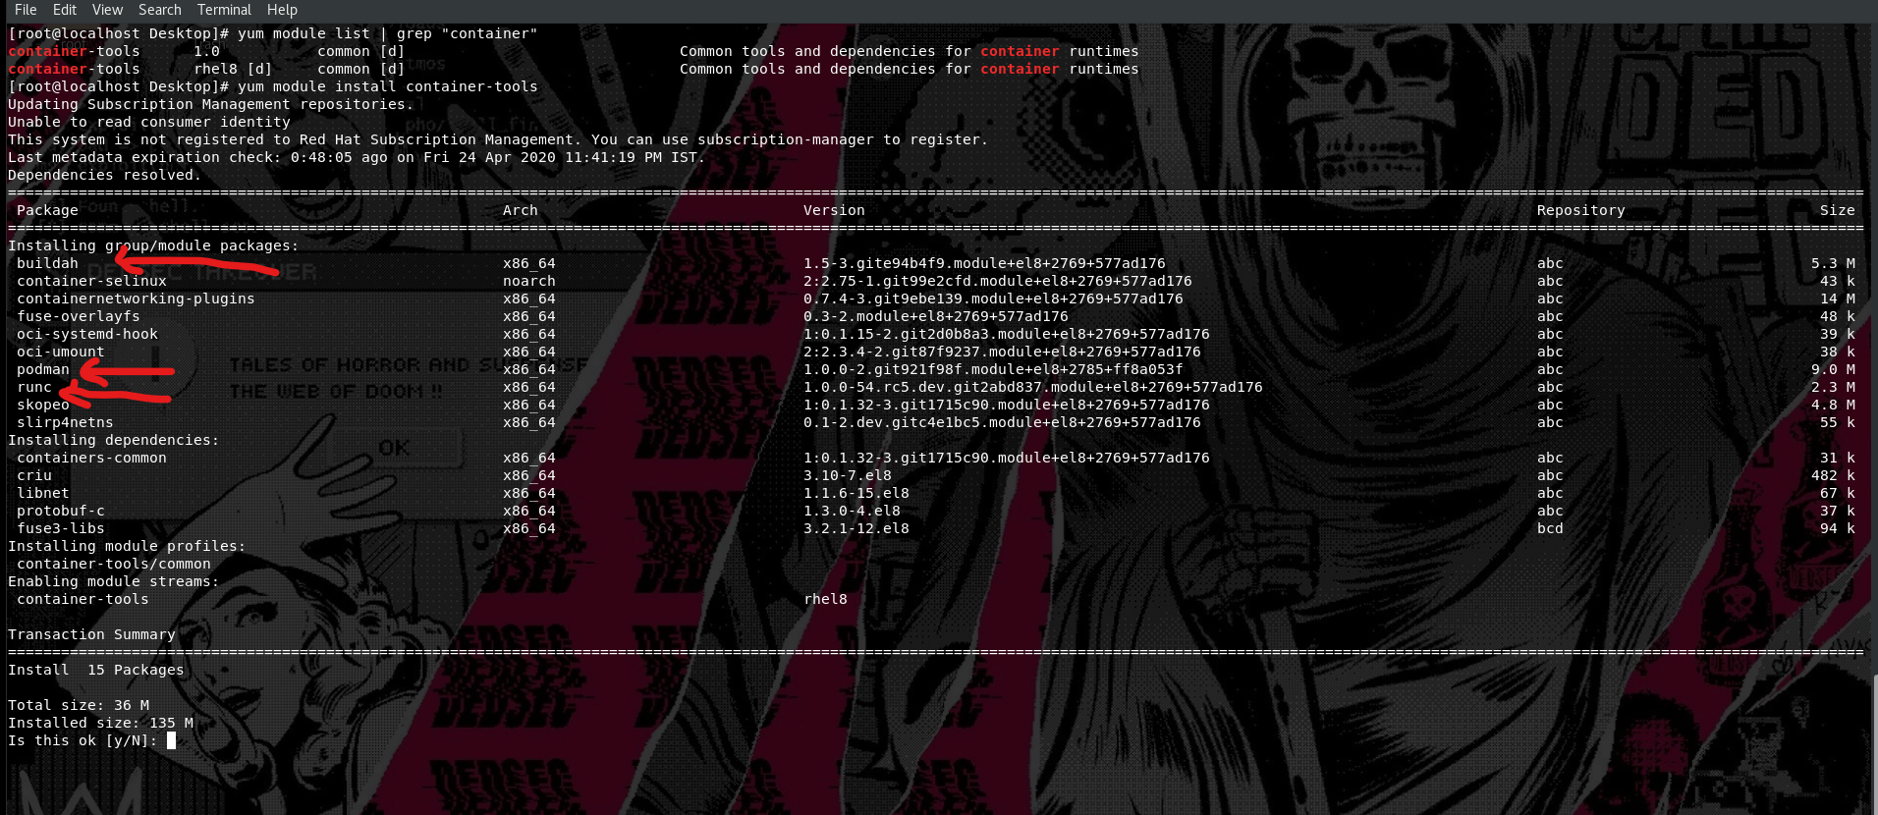

Slide 34
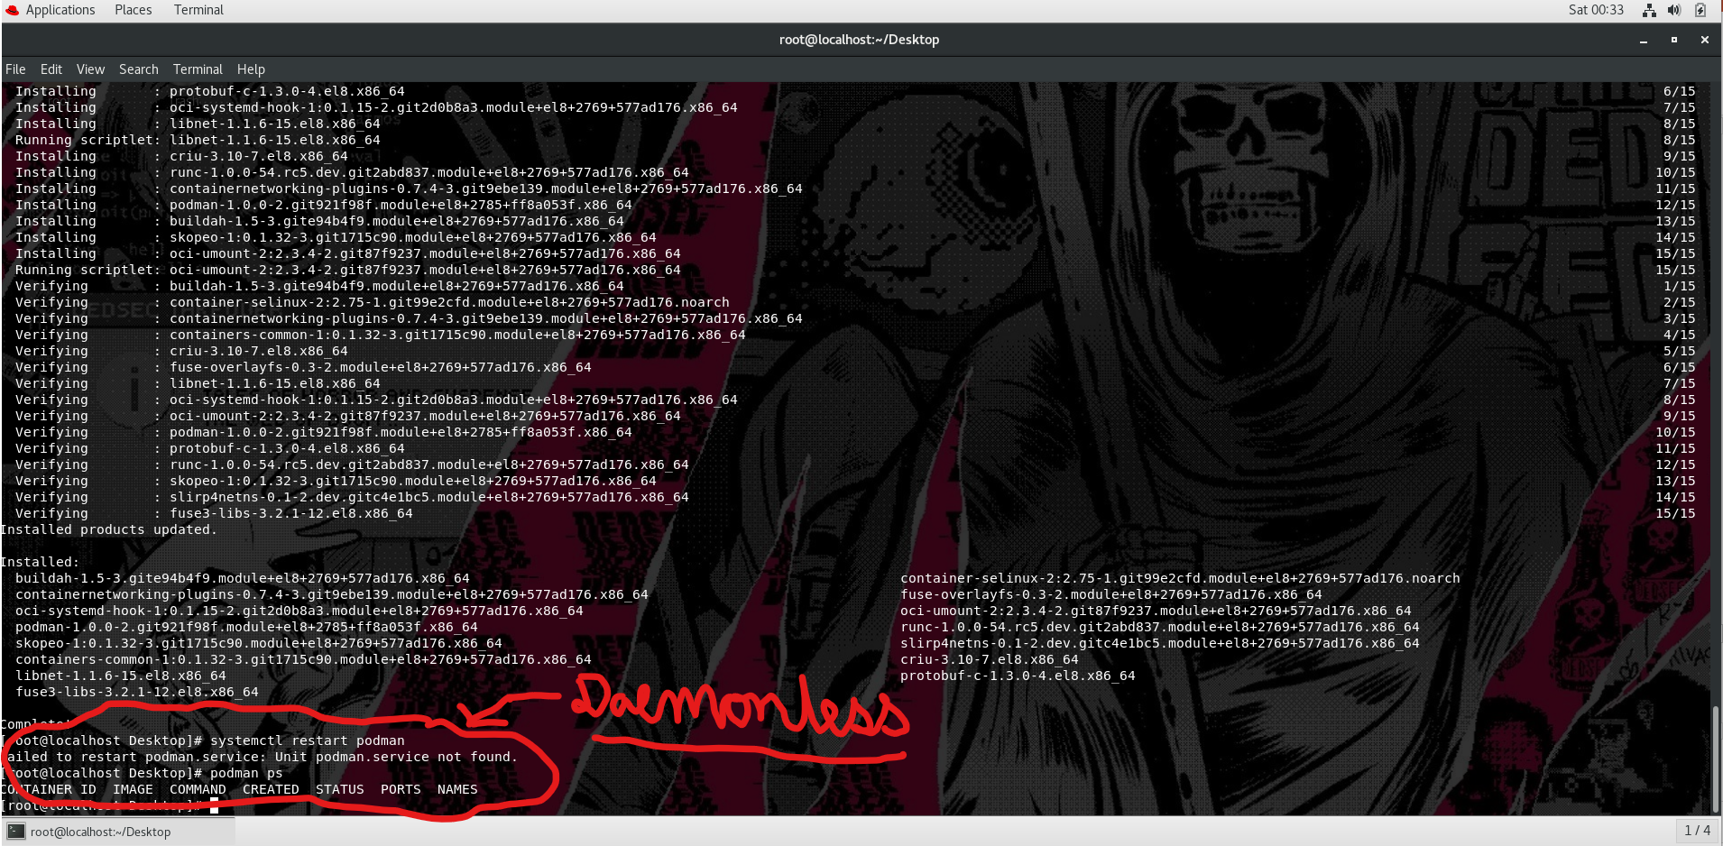

Slide 35
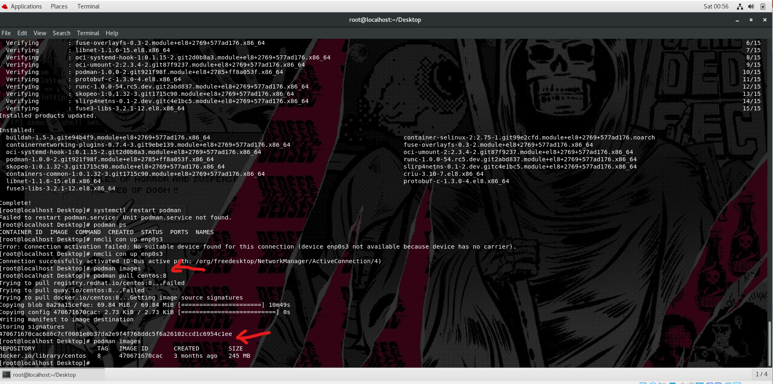

Slide 36
Previous slides in detail
To install Podman:
> configure the RHEL 8 iso local yum
> yum module install container-tools -y
It will install all the container tools which we required for container support.
To check if it’s daemonless run:
> systemctl restart podman.service
> podman pull centos:8
> podman images ( which in turn proves that podman is daemonless / serviceless due to that we need not to start )
( services to use podman )

Slide 37
Thanks For Reading
Docker and Podman are both great tools use them depending on the use cases.
Credits to Vimal Daga sir for teaching me.
Would like to share my knowledge that I have gained from learning also as sharing is caring by sharing what I learnt is like helping myself as well as others. Have a great day.
These slides made By Chandra Shekhar Sharma
LinkedIn profile link: https://www.linkedin.com/in/chandra-shekhar-s-a76b37158/

